Slide 1
IBM Data Science Capstone Project The Battle of Neighbourhoods Final Report

Slide 2
Introduction
Boise has been one of the fastest growing cities in the United States for the past few years according to multiple sources. Main drivers for the population growth include families or retirees moving from other cities/states in search of lower home prices and crime rates, and increasingly more new hires recruited by high-tech companies such as Micron Technology and ON semiconductor. In addition, with the COVID19 outbreak and therefore more companies allowing employees to work remotely from home, Boise has also attracted a lot of out-of-the-states employees that are based in other cities/states. With a growing population comes with a growing demand in restaurants, thus the aim of this project is to study the neighbourhoods in Boise to determine possible locations for opening new restaurants. This project can benefit business owners and entrepreneurs who want to expand their business and invest in Boise.

Slide 3
Data section
Data used in this project are collected from multiple sources, a summary of which is provided below.
The neighbourhood list is scrapped from the city of Boise development website: https://www.cityofboise.org/departments/planning-and-development-services/planning-and-zoning/comprehensive-planning/neighborhood-planning/neighborhood-almanac/ using BeautifulSoup. Data cleaning is performed to remove some inactive neighbourhoods as they are certainly not the ideal locations for any business.
Geographical coordinates are obtained from the GeoPy library in python for the neighbourhood list obtained above.
Venue data are extracted using the Foursquare API and then KMeans clustering is performed to find out the ideal locations for opening new restaurants.

Slide 4
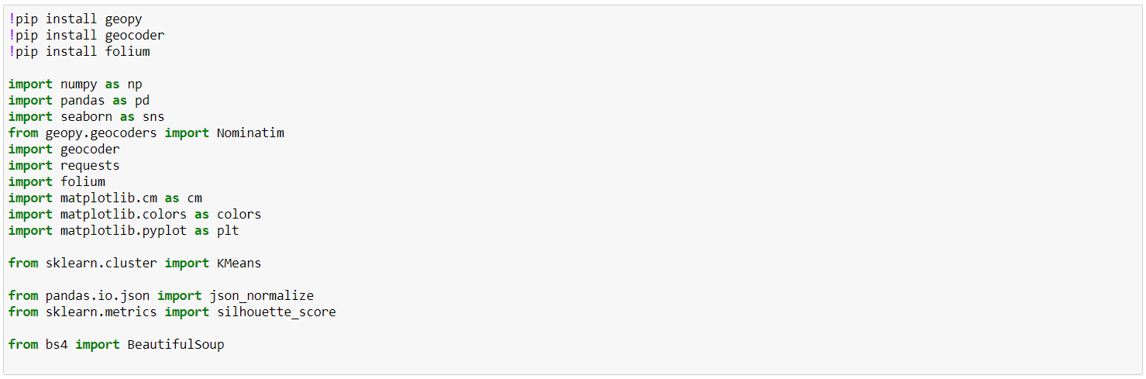
Methodology
Import Python libraries to Jupiter Notebook

Slide 5
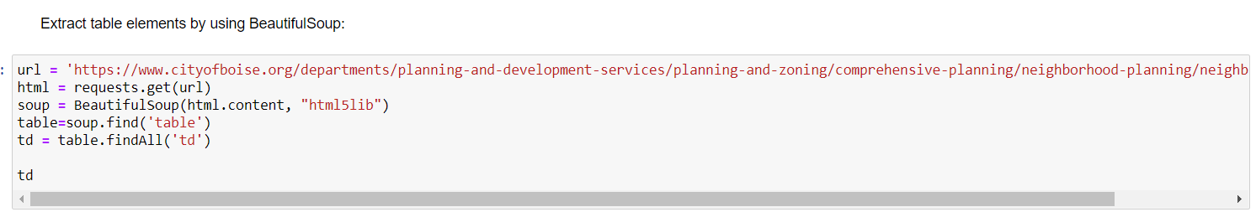
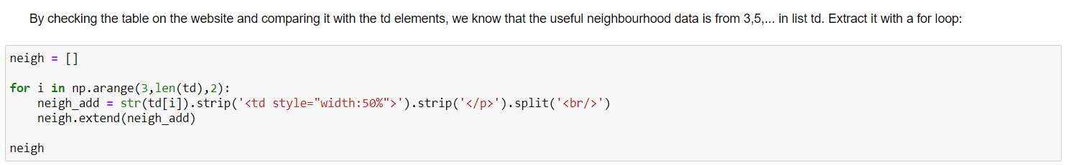
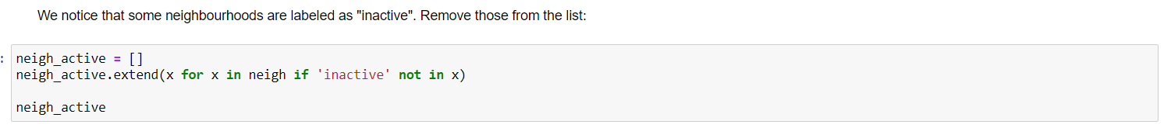
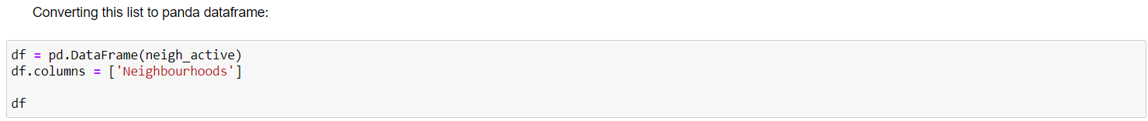
Methodology
Neighbourhood data collection and preprocessing
etc

Slide 6
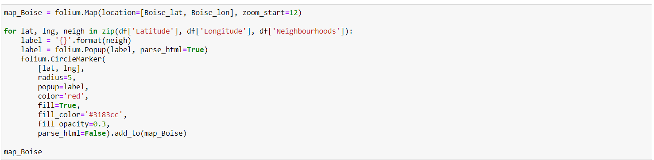
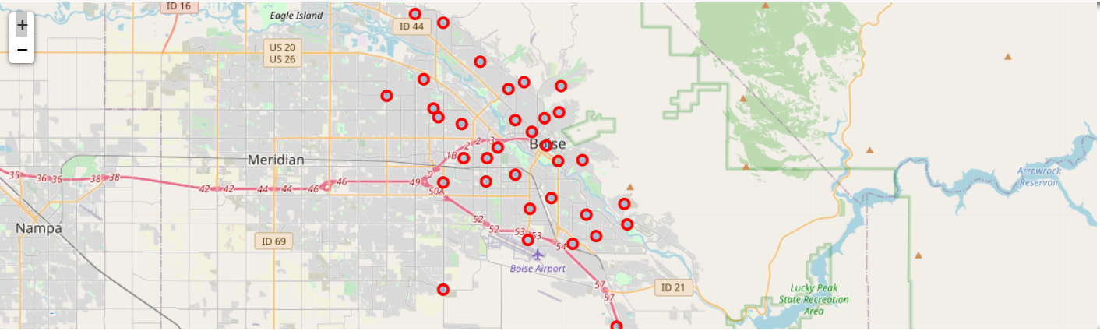
Methodology
Exploratory Data visualization

Slide 7
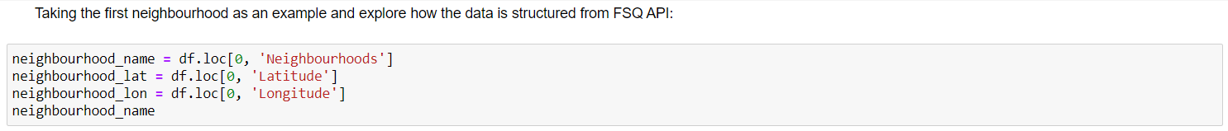
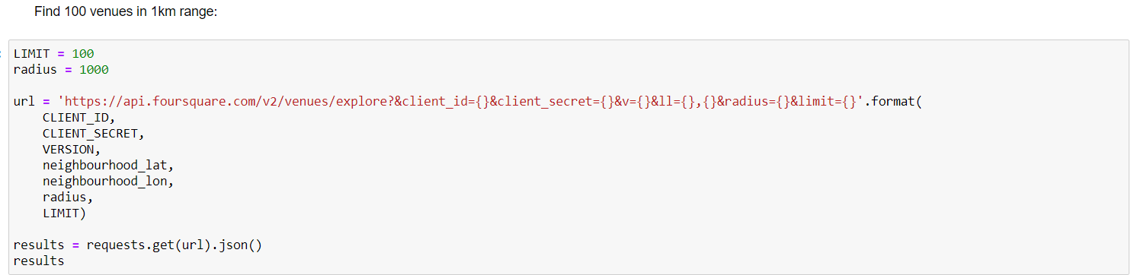
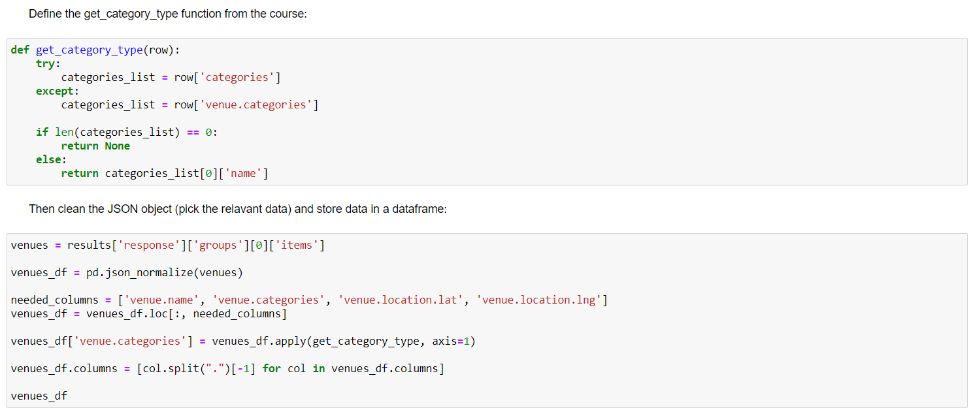
Methodology
Obtaining venue info from FSQ API
etc

Slide 8
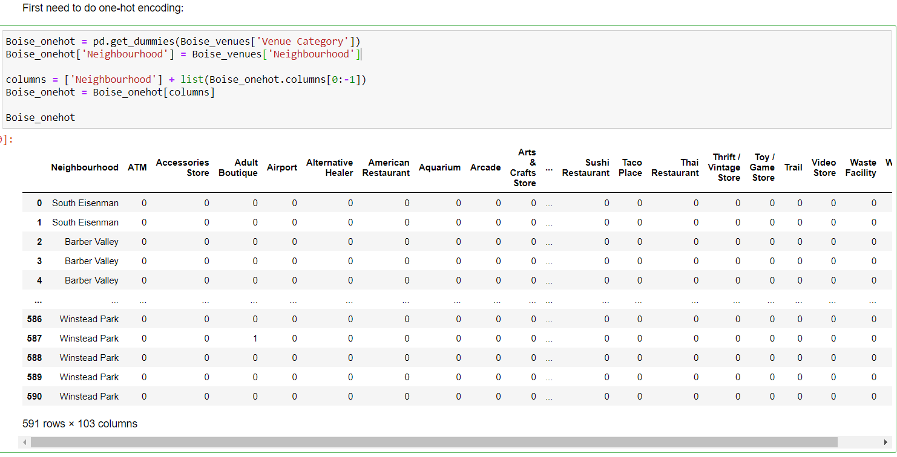
Methodology
One hot encoding

Slide 9
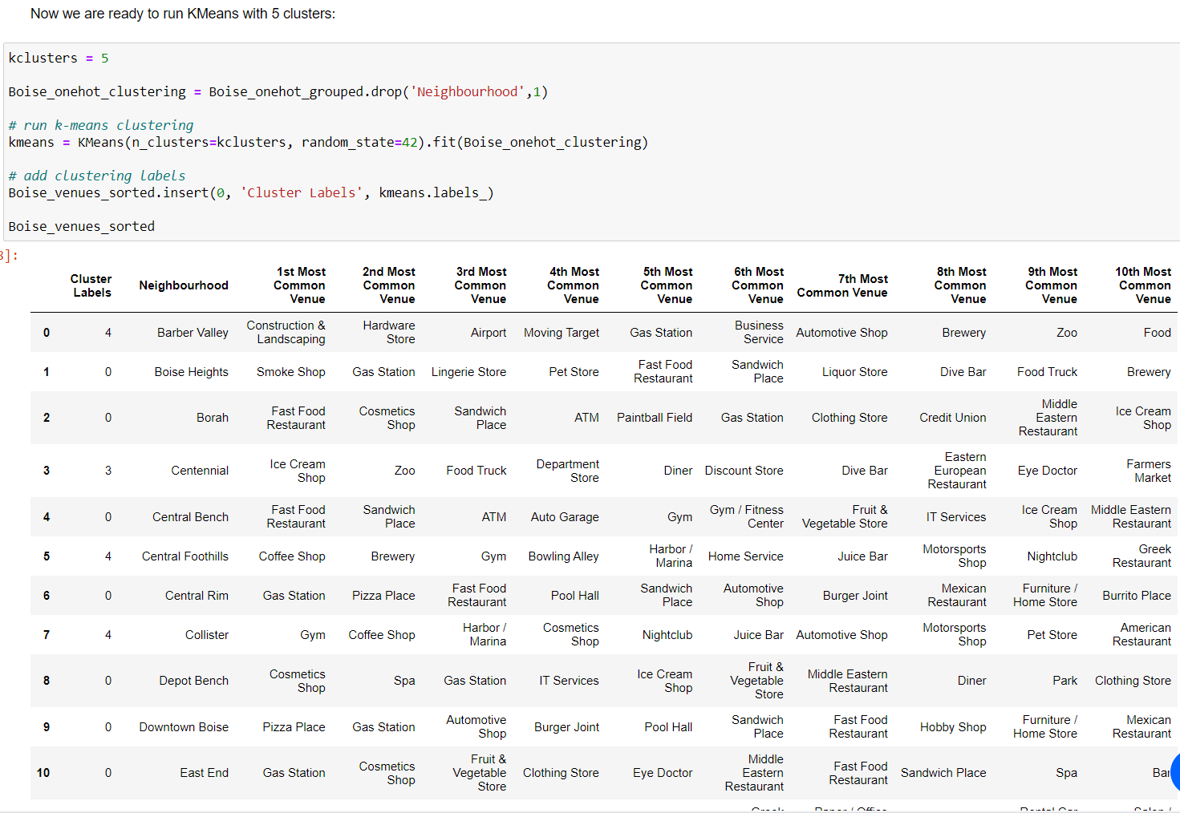
Methodology
KMeans

Slide 10
Results and discussion
By checking the five clusters we obtained above, we notice that some of the clusters have more food related venues in their top 5 most common venues, while other clusters have a mixture of different venues. Neighbourhoods in cluster 0 are the most suitable for opening new restaurants. Finally we merge the coordinates back for plotting map (next slide).

Slide 11
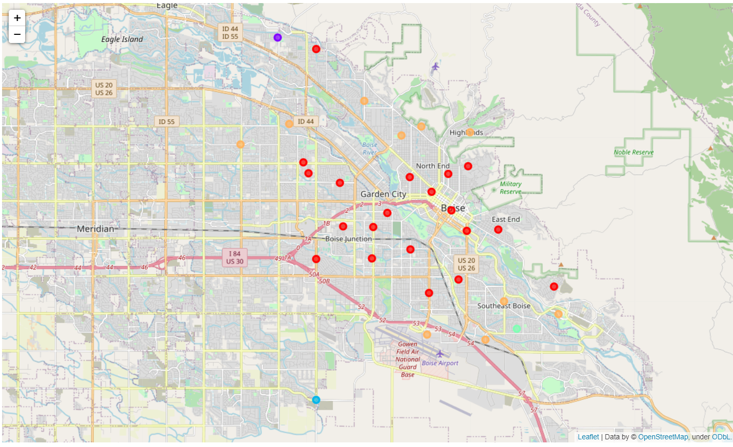
Results and discussion
Cluster map

Slide 12
Conclusion
This project demonstrated basic data science skills in the following aspects: business problem formulation, data collection, preprocessing, exploratory visualization, machine learning and data analysis. The neighbourhoods in Boise are analyzed to provide recommendations for potential business owners to open new restaurants.

